Slide 1

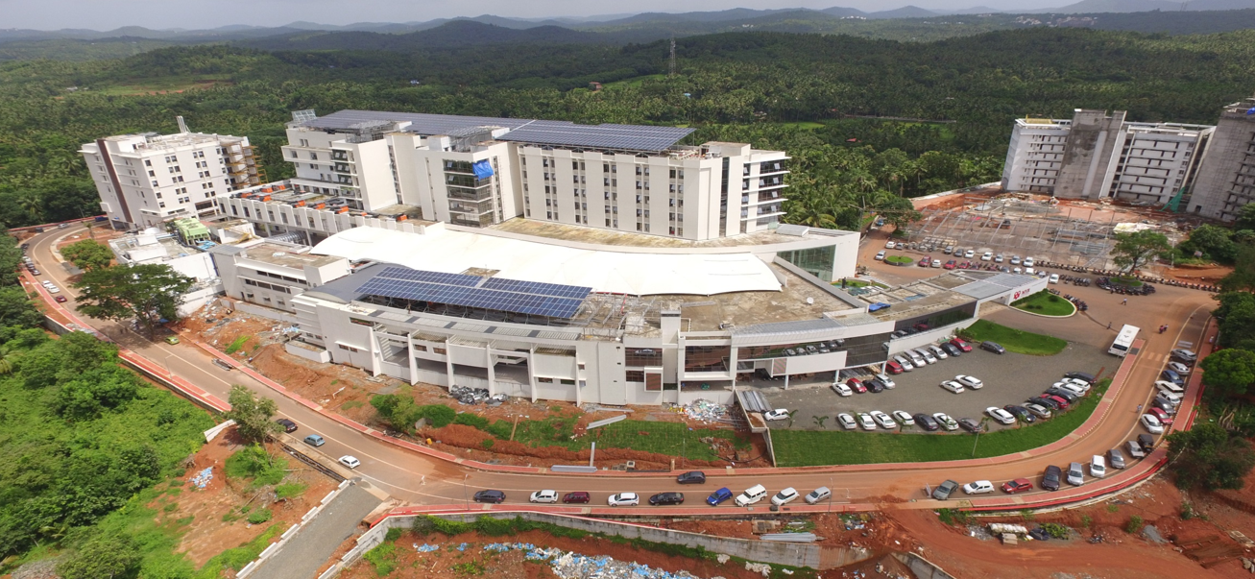
The many shapes of a LINAC
NIYAS PUZHAKKAL
Chief Medical Physicist & RSO
MVR Cancer Centre & Research Institute

Slide 2

Overview
Discussion on shape of a LINAC
How the technology is being shaped
Which are the shapes available from different vendors currently
How do we shape the specification for buying a LINAC

Slide 3

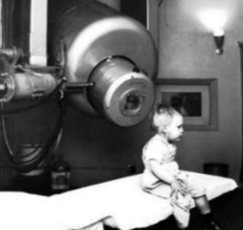
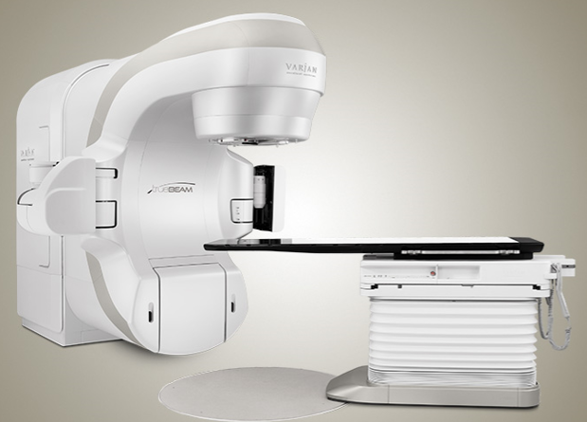
Historical Background
1928 - Rolf Wideroe invents the modern Radio-frequency Accelerator.
1940- idea of using LINAC.
Early 1950 – LINAC in clinical use.
The first LINAC was installed at Hammersmith in 1952.
Non-isocentric machine
Limited gantry motion
The first patient, 2 year old boy, was treated in 1956 at Stanford University, USA
8 MV X-ray
Isocentric machine
With sub mm accuracy

Slide 4

Five generations
Low energy photons – straight beam, Fixed target & FF, symmetric jaws, single ion chamber. (1953-1961)
Medium energy photons & electrons – bent beams, movable target & FF, dual ion chamber, electron cones. (1962-1982)
High energy photons & electrons – Dual photons & multiple electrons, bending magnet, dual scattering foils, asymmetric collimator.
Multiple energy photons and electrons – Computer controlled operation, dynamic wedge, EPID, MLC.
Multiple energy system with photon modulation – Intensity modulation with MLC, gantry and dose rate, Image guided system.

Slide 5
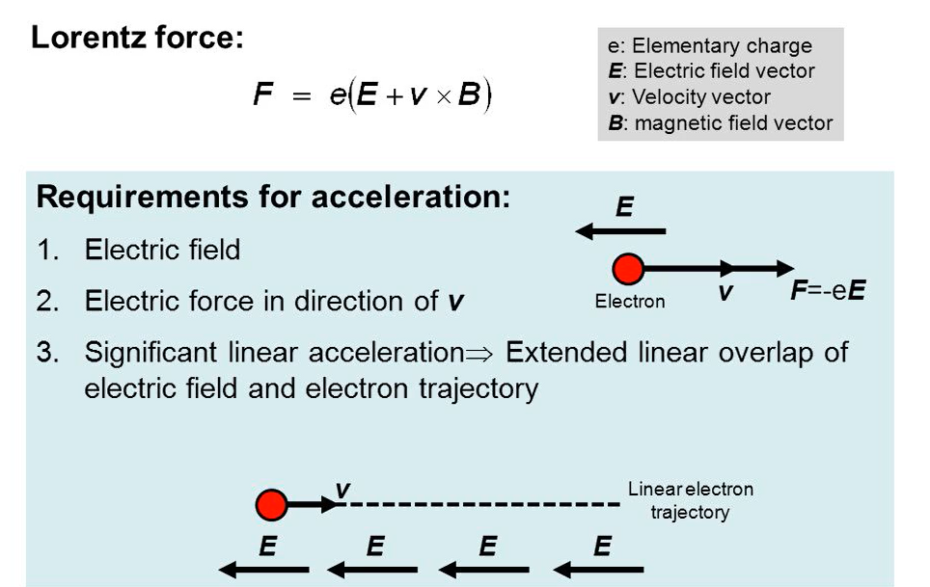
Basics of electron acceleration

Slide 6
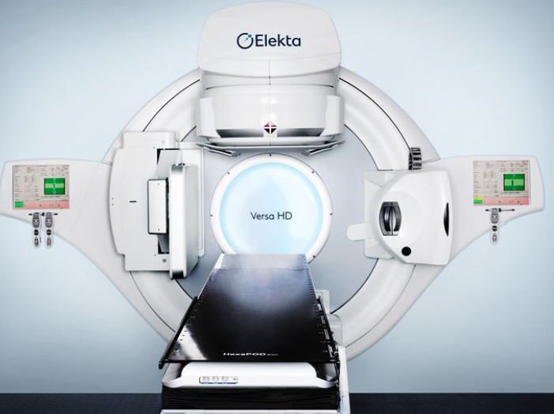
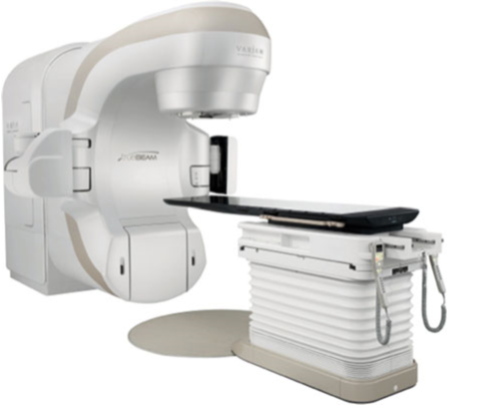
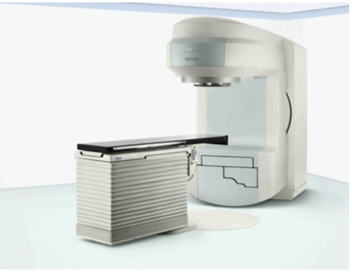
Commercial LINACs
3 major vendors in USA – leading in market (now only 2)
Capable of producing multiple photon & electron energies
Elekta – Synergy, Infinity & Versa HD.
Varian – Clinac, Trilogy & Truebeam
Siemens – Primus, Oncor & Artiste

Slide 7
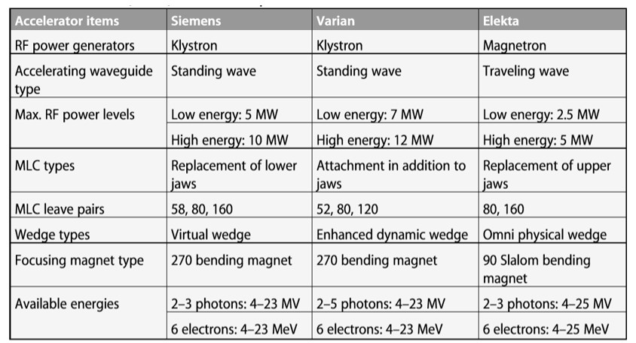
Comparison in short

Slide 8
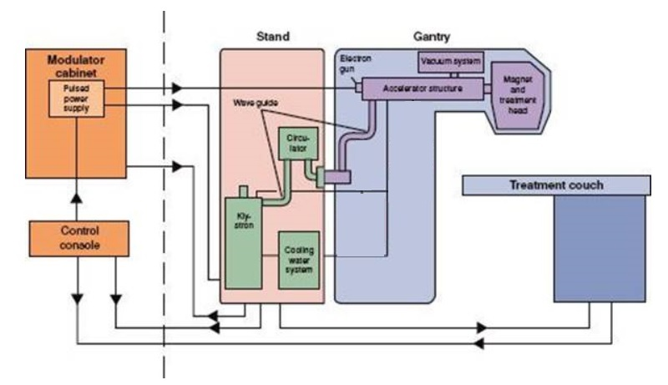
Components of LINAC
Modulator
Drive stand
Gantry
Treatment couch
Modulator cabinet – power distribution system
converts the ac current into pulses of flat topped dc current
Electron gun & microwave power source
Notes:
Modulator cabinet It has a fan control, auxiliary power distribution and primary power distribution system.
The modulator converts the ac current into pulses of flat topped dc current
These are fed to the electron gun and to the microwave power source.

Slide 9
Drive stand
RF power source
Assistance for driving the gantry.
RF transmission waveguide
4 major components
Water cooling system
Circulator
The high frequency em radiation is produced by RF power source.
Two types: Magnetron & Klystron

Slide 10
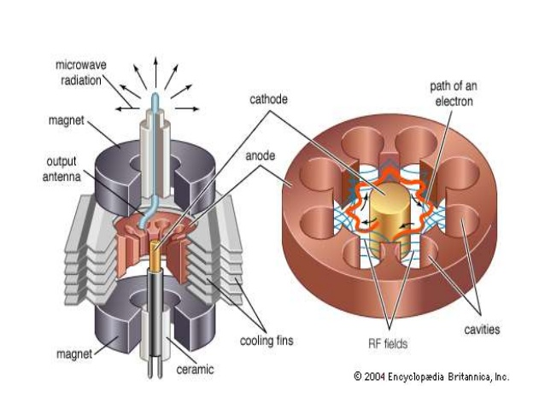
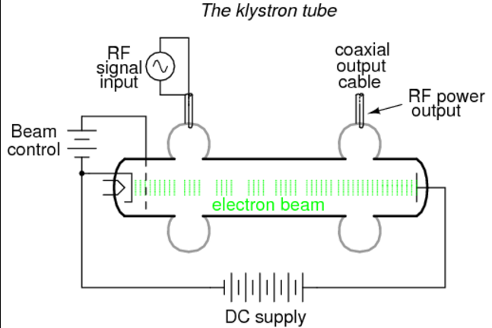
Micro wave power source
Magnetron – 5 MW Klystron – 7 MW

Slide 11

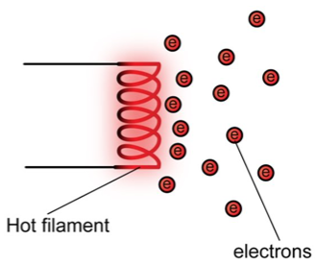
Gantry
Gantry directs the beam to the patient by rotating around the patient.
Electron gun
Accelerating waveguide
Treatment head
Electron gun: Produces electron by thermionic emission of heated cathode.

Slide 12
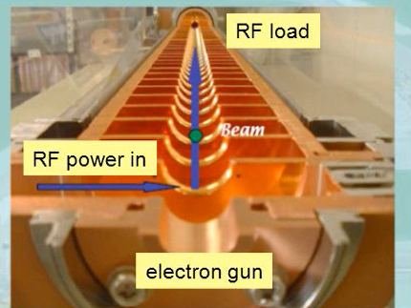
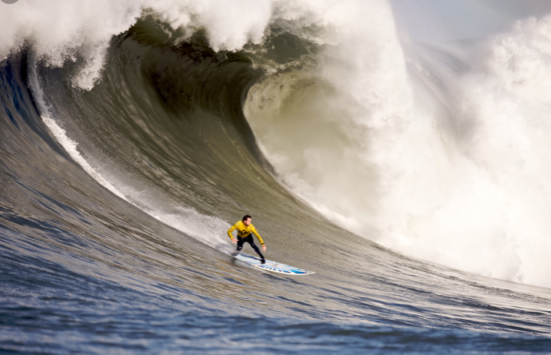

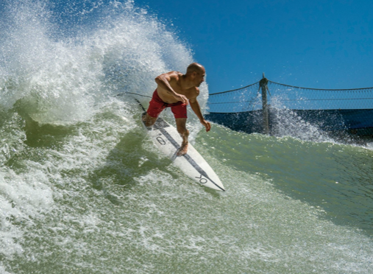
Accelerating waveguide
Evacuated metallic circular structures.
Accelerates electrons with the help of micro wave power.
High conductivity ensures the stability & accuracy
Made up of Cu. Why?
High Vacuum – to prevent electron loss and arcing
Length = 30 cm – 3 m
Complete hollow structure is not suitable. Why?
Microwaves are transmitted much faster than the injected electrons.
Series of cavities

Slide 13
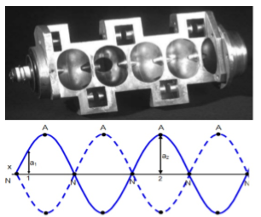
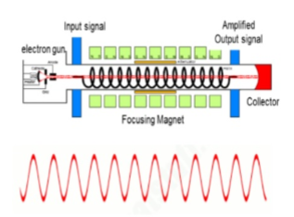
Two types
Travelling
Standing
Each end is terminated with a conducting disc to reflect the microwave power
Results in formation of standing waves.
can be effectively shortened the accelerating waveguide by 50%.
Microwaves enter on the gun side and propagate.
Absorbed at the distal surface and thus forms a travelling wave pattern.
Notes:
Standing waveguide
In this configuration, every second cavity carries no electric field
can be effectively shortened the accelerating waveguide by 50%.

Slide 14

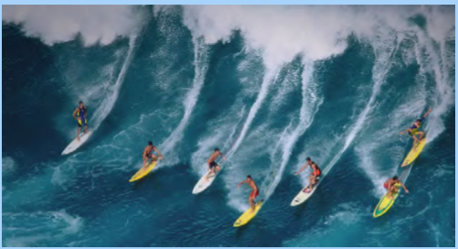
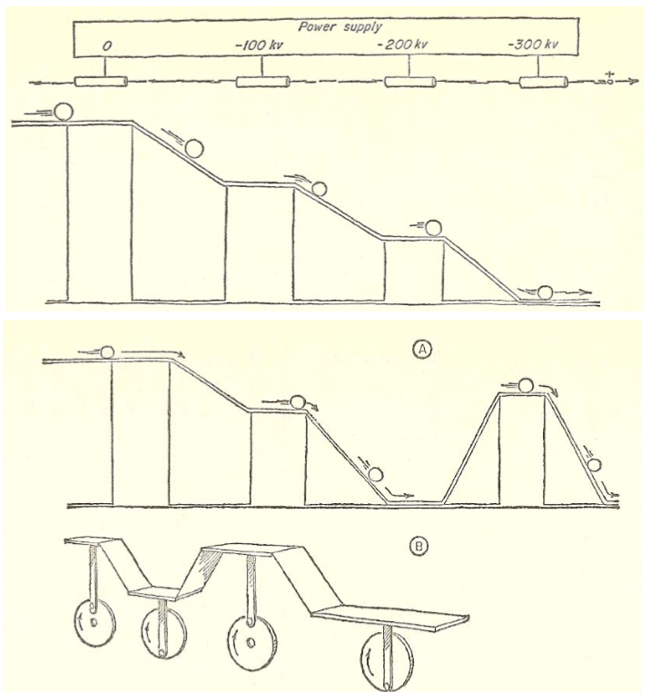

A person surfing on the crest of an ocean wave…. Surfer is analogous to electron & water wave – microwave power

Slide 15
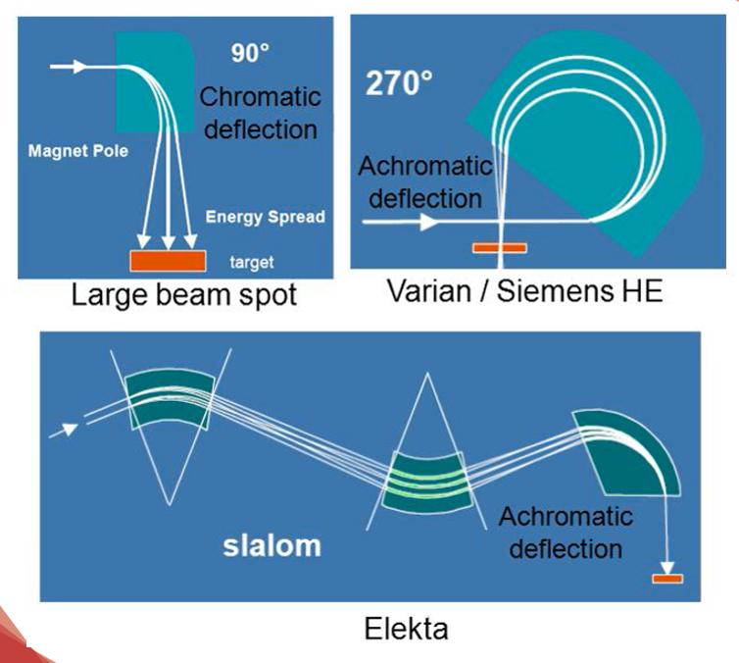
Bending magnet
At the exit of the waveguide the e beam passes through a bending magnet system
Directed towards the treatment head.

Slide 16
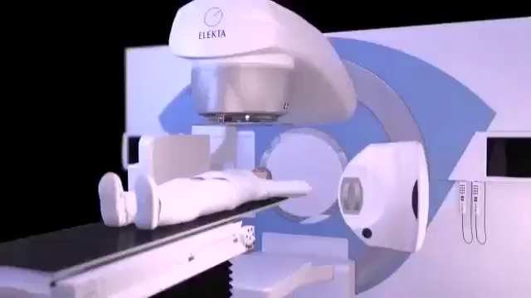

Slide 17
Physics of X-ray

Slide 18
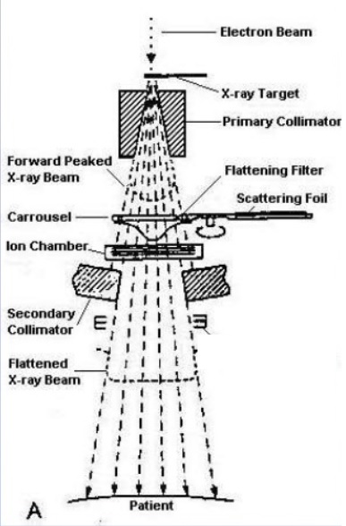
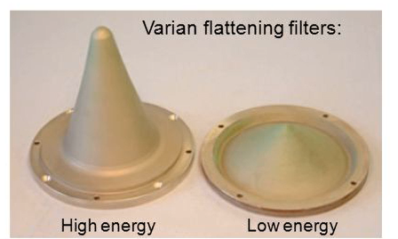
Treatment head
Electrons Tungsten target forward peaking X-rays.
Fixed primary collimator
Flattening filter Flattened, symmetrical & uniform beam.
Scattering foil Electron mode
Monitor ionization chamber Dose, dose rate & symmetry.
Secondary collimator Rectangular or square shaped X-ray beams
Notes:
Treatment head is shielded with lead and tungsten.
The high energy electrons, in the form of a narrow pencil beam, exiting from the end window of the accelerator falls on the Tungsten target placed in the path of the beam, generates a forward peaking shaped X-rays.
fixed primary collimator made up of high atomic number elements to minimise the leakage and absorb the scattered X-rays.
The forward peaking X-ray beam is allowed to pass through a flattening filter to obtain a flattened, symmetrical and uniform beam.
Monitor chambers read 1MU when an absorbed dose of 1 cGy is delivered to a point at depth of maximum dose (d_{max}) and field size of 10x10 cm² in a water phantom, when the phantom surface is positioned at 100 cm from the target.

Slide 19





Monitor Units
Radiation output is represented by MU
LINAC is calibrated to deliver 1.0 cGy/MU.
Monitor chambers read 1MU when an absorbed dose of 1 cGy is delivered to a point at depth of maximum dose (d_{max}) and field size of 10x10 cm² in a water phantom, when the phantom surface is positioned at 100 cm from the source.
Analogous to the treatment time in Telecobalt.
Dose rate

Slide 20
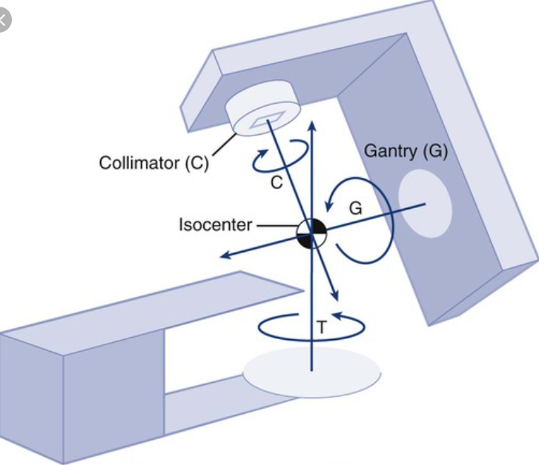
Isocentre
One of the important parameter of the machine
Theoretically isocentre is the fixed point of intersection.
Closest within a best compromise sphere.
The centre of this sphere is the nominal isocentre.
Mechanical stability and accuracy of isocentre.
Very much critical in stereotactic treatments
For LINAC based SRS, the dia. of the sphere must not exceed 1.0 mm
Notes:
Requirement is more stringent in radiosurgery than in routine radiotherapy.

Slide 21
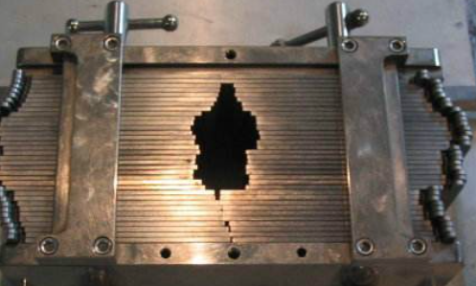
Multi-leaf Collimator
Field shaping device – irregular fields.
Intensity modulation of X-rays.
Material – Tungsten alloy
High density, hard, low coefficient of expansion.
Thickness – 6 - 8 cm
Density – 17-18.5 g/cc
Transmission – Intra-leaf < 2%.
Interleaf <3%
Notes:
Computer-controlled leaves move independently.
large number of leaves made up of heavy metal alloy.
Its computer-controlled leaves act as a filter, move independently and transmit radiation in the form of small beamlets in order to conform the field to the shape of the tumor.
Iso-centre is a point in space at 100 cm from target through which the central axis of radiation beam passes.

Slide 22

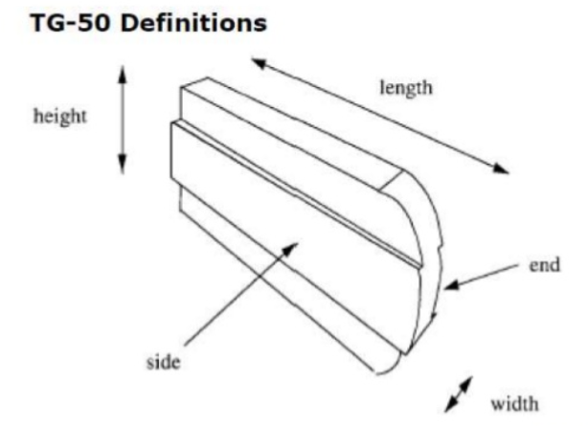
Leaf specification varies between vendors…
Leaf width
Leaf numbers
Leaf length
Leaf end
Leaf sides
Leaf height

Slide 23




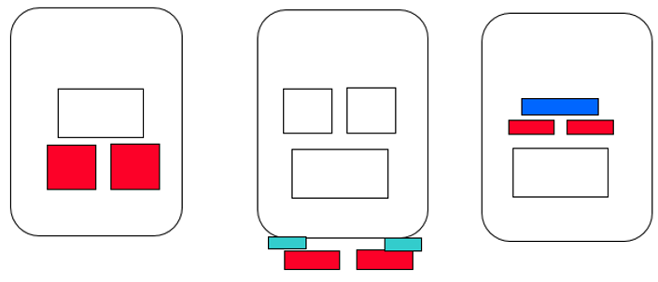
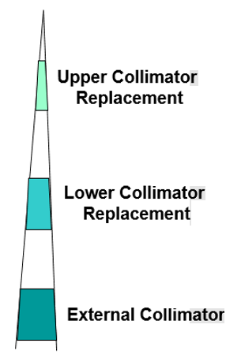
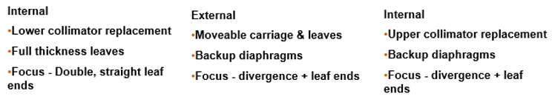

Slide 24
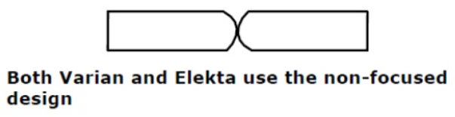
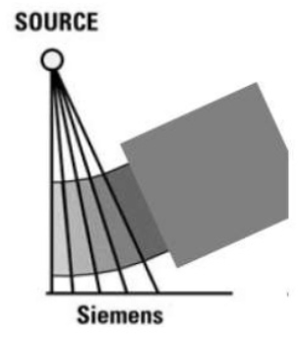
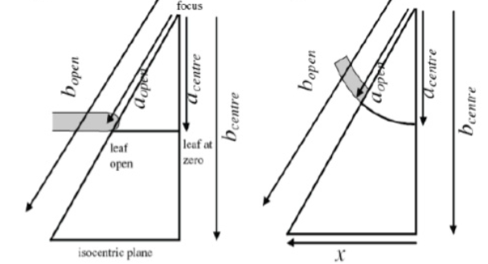
MLC design – Leaf ends
Non-focused (rounded) leaf ends
Relatively higher penumbra
Potential for grater leaf end transmission

Slide 25
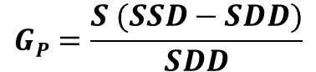
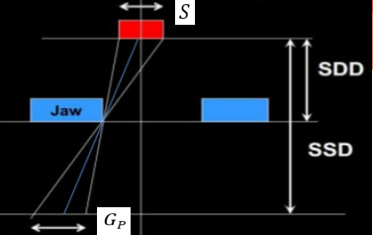
Penumbra- does it depend on collimator?
Penumbra – region where the dose changes rapidly as a function of distance from CAX
Geometric Penumbra
Transmission Penumbra
Scattering Penumbra

Slide 26
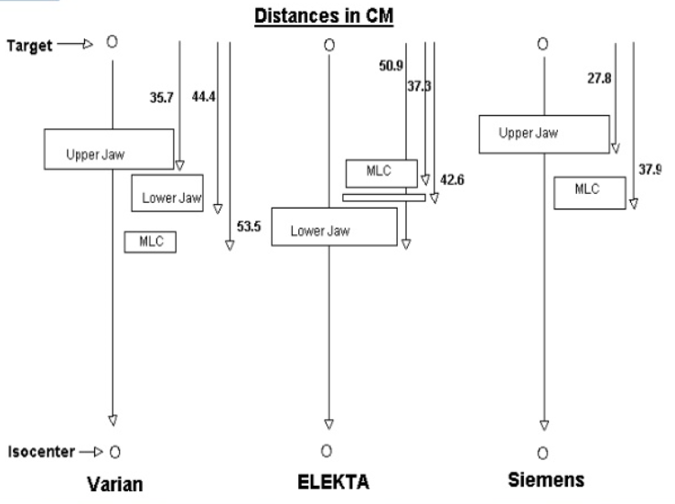
Siemens system has intrinsically high geometric penumbra.
However, doubly focused configuration reduces the transmission penumbra

Slide 27
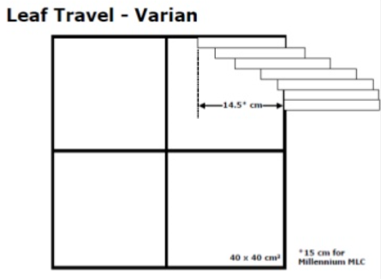
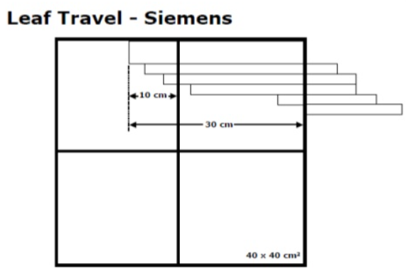
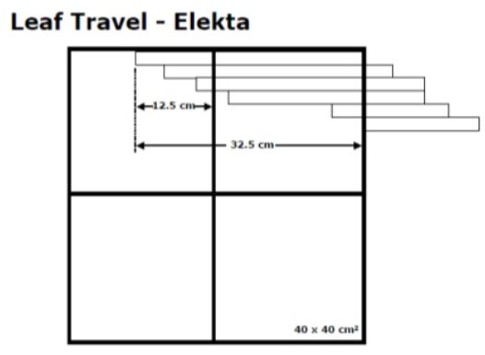

Motion limitation

Slide 28
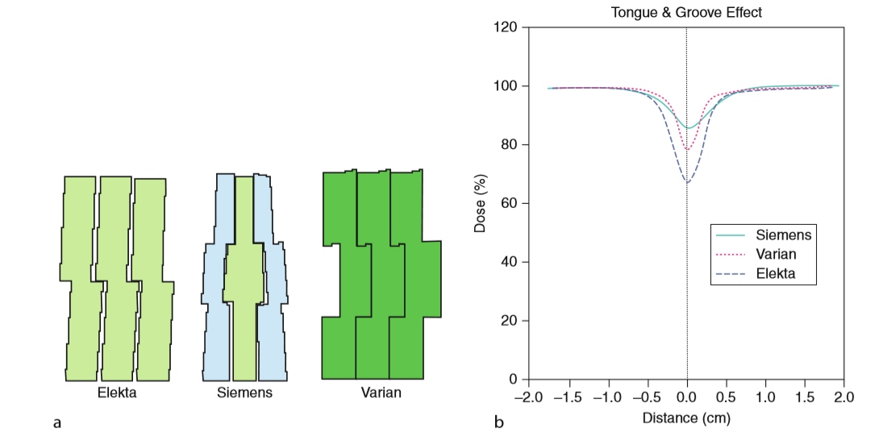
Tongue and groove arrangement of MLC
To minimize interleaf leakage
Under dosage in IMRT delivery when two segments abut- TGU
The amount of TGU related to the length of the shared borders.

Slide 29

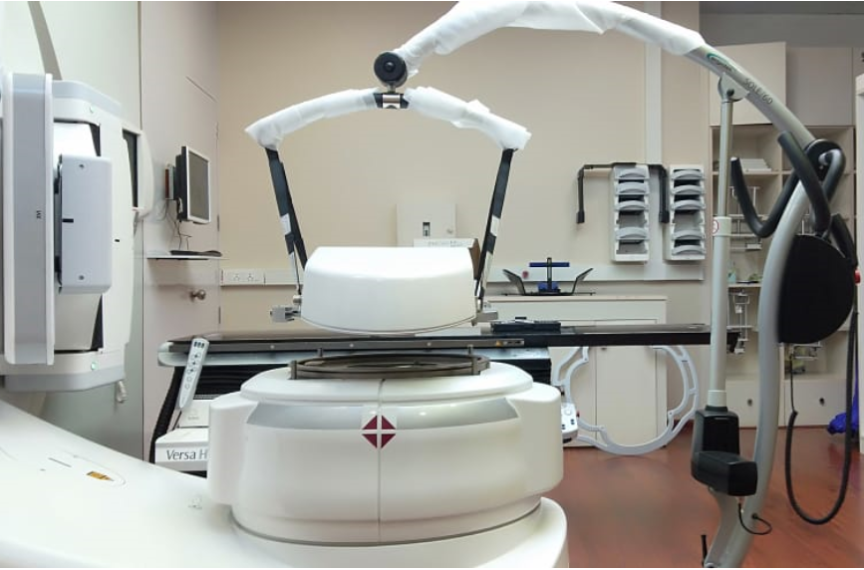
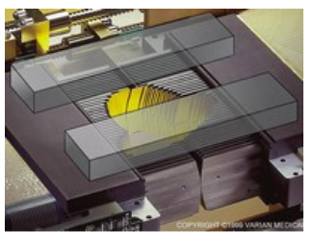
Comparison of MLCs
Agility
Millennium
160 leaves
Resolution=5 mm
Max. F S = 40 cm x 40 cm
Max. Leaf speed = 6.5 cm/s
120 leaves
Resolution 5 & 10 mm
Max. F S = 40 cm x 40 cm
Max. Leaf speed = 2.5 cm/s
Apex Micro MLC
112 leaves
Resolution 2.49 mm
Max. F S = 14 cm x 12 cm
HD 120 Micro MLC
120 leaves
Resolution=2.5 & 5.0 mm
Max. F S = 40 cm x 22 cm

Slide 30
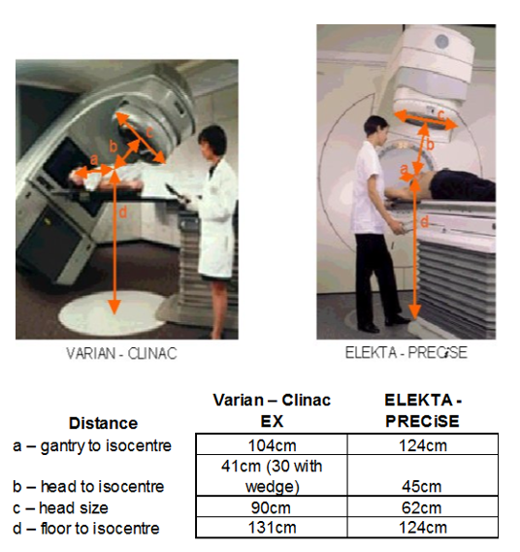

Slide 31
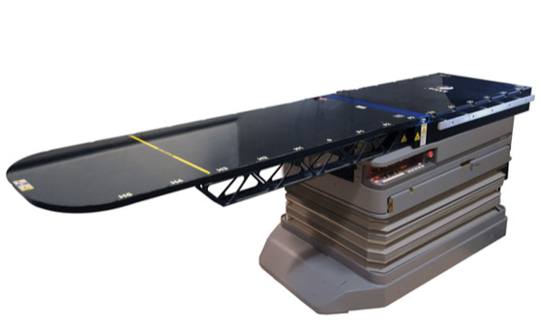
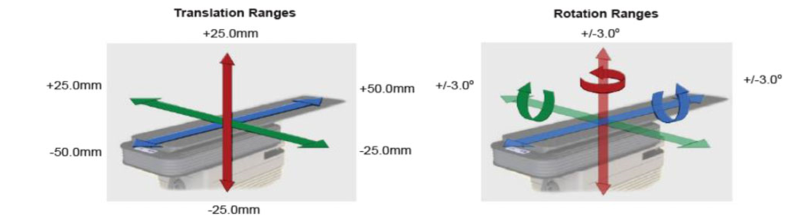
Treatment couch
Treatment couch is the place where the patient lies down for the treatment.
Movement in longitudinal, lateral, vertical and rotational
Robotic couches with more rotational degree of freedom.

Slide 32
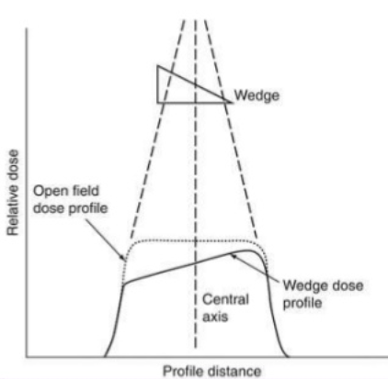
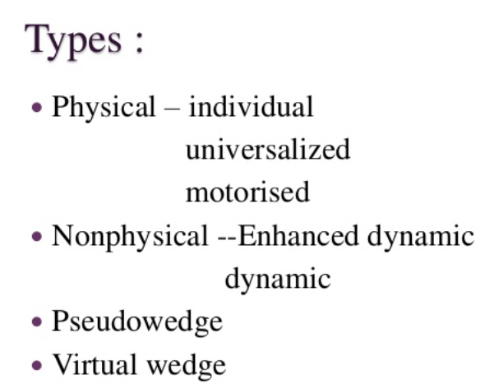
Wedge as beam modifier
Tilting of isodose curves

Slide 33
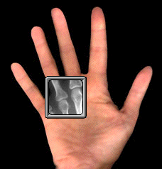
Imaging for treatment setup verification
Set-up difficulties
Soft tissue deformation
Tumor growth/shrinkage
Irregular respiration
Spontaneous motion
What is our solution??
Electronic portal imaging
KV imaging
Cone beam CT (KV/MV)
MR imaging

Slide 34
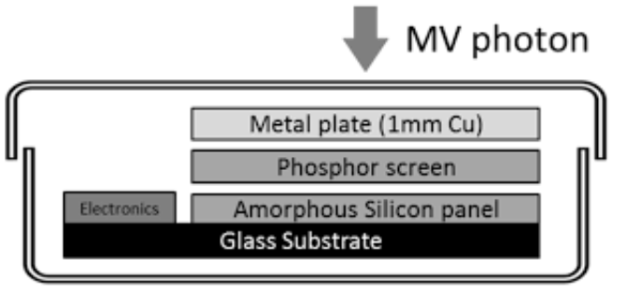
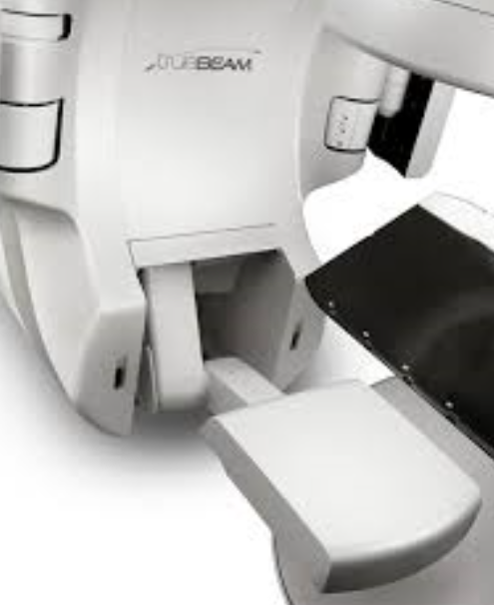
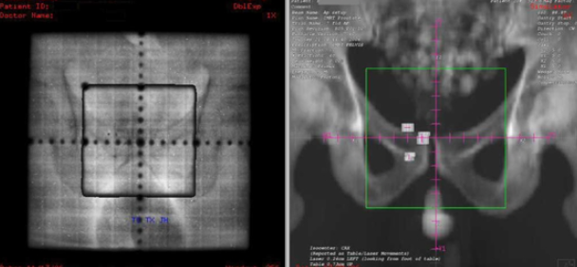
EPID
Fluoroscopy system (Video based)
Matrix ionization chamber based system
Amorphous silicon based system
Detector : Amorphous silicon flat panel Active imaging area : 40 x 30 cm2
Spatial resolution : 0.391 mm
Energy range : 4 - 25 MV

Slide 35



KV imaging
Imaging by using X-rays in KV energy
Dedicated X-ray tube
Either attached with LINAC or fixed on ceiling /floor
2D digital flat panel detector to yield a 3D volumetric image in one rotation.

Slide 36








How many shapes??
Compact
Precise
Synergy Platform
Synergy
Infinity
Axesse
Versa HD
Unity

Slide 37

Comparison chart

Slide 38








Any more shapes??
Clinac 21EX
Clinac 2100C/D
Clinac iX
Trilogy
TrueBeam
Unique
Edge
Halcyon

Slide 39

Comparison chart

Slide 40




Low power generator – less operating cost
Agility head – leaf speed, ultra low transmission, 45 cm clearance, Rubicon optical technology
Wedge technology
Beam stability – Klystron
Connectivity with the OIS
Small vault configuration
Excellent HD MLC

Slide 41
Power consumption
Name of the Vendor | Elekta
Items | Power consumed (KVA) | Approx. ON time (hr) | Total unit / day | Total unit / month
Vacum Stand by | 2 | 24.00 | 48.0 | 1440
LINAC ON- stand by | 10 | 12.00 | 120.0 | 3000
LINAC - Beam ON | 30 | 2.00 | 60.0 | 1500
XVI - Stand by | 5 | 12.00 | 60.0 | 1500
XVI - ON | 50 | 1.00 | 50.0 | 1250
 |  |  | Total | 8690
 |  |  | Cost per unit | 9
 |  |  | Total cost, RS. | 78210
Name of the Vendor | Varian
Items | Power consumed (KVA) | Approx. ON time (hr) | Total unit / day | Total unit / month
Vacum Stand by | 5 | 24.00 | 120.0 | 3600
LINAC ON- stand by | 20 | 12.00 | 240.0 | 6000
LINAC - Beam ON | 48 | 2.00 | 96.0 | 2400
XVI - Stand by (apx) | 5 | 12.00 | 60.0 | 1500
XVI – ON (apx) | 50 | 1.00 | 50.0 | 1250
 |  |  | Total | 14750
 |  |  | Cost per unit | 9
 |  |  | Total cost, RS. | 132750

Slide 42
How do you buy a LINAC
Shape your technical specification
Sl. No. | Specification
1 | Dose Delivery & Beam Characteristics
 | Highest Photon dose rate in MU/Min
 | Highest FFF dose rate in MU/ Min
 | Highest electron dose rate MU / Min
 | Field Flatness
2 | System Integration
 | Explain Level of Integration with respect to the linear acclerator, MLC, Integrated Dosimetry and verification system, 6D Couch, Portal Imaging, KV imaging System, µMLC, TPS and OIS. Explain how this integration helps in therapy in terms accuracy, precision and time?
3 | System Accuracy in SUB MILLIMETER
 | Gantry
 | Couch
 | Collimeter
4 | Portal Imaging
 | Detector Size
 | Active Imaging area
 | Resolution
 | Dosimetry application , Specify in case of any unique application using portal Imaging.
5 | KV Imaging
 | Imaging modes available
 | Detector Size
 | Active Imaging area
 | Resolution
 | Specify other applications
6 | Integrated QA and Dosimetry Systems
 | Specify the features and applications of integrated QA and Dosimetry Systems
7 | Treatment Planning System
 | Specify the UNIQUE features of TPS, If any..
 | Planning algorithm used
 | List of Optimisation softwares provided as standard
8 | Oncology Information System
 | Specify the UNIQUE features of OIS, If any..
9 | MLC
 | Max Field Size
 | Min Field Size
 | Number of leaves
 | Average leaf transmission
 | Maximum leaf speed
 | Maximum over center travel distance
 | Maximum Leaf retracting distance in cm
 | Leaf position accuracy
 | Up gradation of MLC's
 | MLC resolution
 | Field size range
 | Leaf span
 | MLC Leaf width
 | MLC Leaf thickness
 | MLC Leakage (Including intra leaf leakage)
 | MLC Leaf Material
 | Maximum step size in mm
 | Light and Xray field coincidence (Congruence)
 | Penumbra

Slide 43
10 | µMLC
 | Max Field Size
 | Min Field Size
 | Number of leaves
 | Average leaf transmission
 | Maximum leaf speed
 | Maximum over center travel distance
 | Maximum Leaf retracting distance in cm
 | Leaf position accuracy
 | Up gradation of µMLC's
 | µMLC resolution
 | Leaf span
 | MLC Leaf width
 | MLC Leaf thickness
 | MLC Leakage (Including intra leaf leakage)
 | MLC Leaf Material
 | Maximum step size in mm
 | Light and Xray field coincidence (Congruence)
 | Penumbra
11 | Network Capabilities & Server Configuration
 | Capability to interface with Hospital PACS
 | Capability remote access to the plans
 | DICOM 3 Ready for all activities like store, print, archive, retrieve etc
 | Specify any other networking feature availble?
12 | Motion Management Systems
 | Specify the details of motion management features availed. Indicate the advantage ?
13 | Respiratory Motion Management System
 | Specify the details of respiratory motion management features availed. Indicate the advantage ?
14 | Knowledge based Treatment Planning support algorithms
 | Details of knowledge based treatment planning and contouring systems which are availed as standard

Slide 44



Salient features of latest platforms
Improved imaging
Fast and precise
Upgradability
Efficiency
Most reliable equipment
Remote support

Slide 45

Effective comparison and negotiation

Slide 46


Effective Comparison….
Most difficult part….
Scientific approach
Technical optimization
Price negotiation
Loss of technology
Benefit of money

Slide 47

Price or functionalities???
Don’t allow the vendor to speak the term quality, which is not measurable.
Don’t allow to speak cost factor, repeatedly, which is a biasing factor.
Convert quality into quantity Q_{i}
Convert cost into cost for value
Workout for a w. factor (user’s need, priority) W_{i}
Value, V = ∑Q_{i} .W_{i}
V/C Value / Cost
Effective comparison in terms of V/C
?
V/C
V/C

Slide 48
Specification | W. Factor | Vendor 1 | Vendor 2 | Remarks | Vendor 1, Qi | Vendor 2, Qi | Vendor 1, Vi | Vendor 2 Vi
Dose Delivery & Beam Characteristics
Highest Photon dose rate in MU/Min | 3 | 600 Mu/Min | 600 MU/min | Not only Just affects the tthroug-put, but improves the qaulity of th treatement, as it reduces the patient's time on the couch | 5 | 5 | 15 | 15
Highest FFF dose rate in MU/ Min | 2 | For 6X it is 1400 Mu/min and for 10X it is 2400 Mu/min | Max dose rate 2200 MU /min for 10 MV FFF Photon energy, 6 X1400 MU/Min | Highest in industry , Not only Just affects the tthroug-put, but improves the qaulity of th treatement, as it reduces the patient's time on the couch | 5 | 4 | 10 | 8
Highest electron dose rate MU / Min | 2.5 | 1000 Mu/Min | The Electrons max dose rate is 600 MU/min | Highest in industry ,Not only Just affects the tthroug-put, but improves the qaulity of th treatement, as it reduces the patient's time on the couch | 5 | 4 | 12.5 | 10
Penumbra in mm at a TSD of 100cm. | 5 | Its within the range as per the guidelines of IEC and AERB standards | Penumbra less than 5.5 mm at dmax (flat beams) • less than 5.5 mm at dmax for field sizes 5 cm x 5 cm to 15 cm x 15 cm |  | 4 | 5 | 20 | 25
Field Flatness | 4 | + 2.5% to + 3.0% | Field Flatness is equal or less than ±2% | well within the industry and safety norms | 8 | 5 | 28 | 20
Excel sheet

Slide 49
Portal Imaging
Detector Size | 3 | 43 x 43 cm2 | 41x41 cm2 |  | 5 | 4 | 15 | 12
Active Imaging area | 4 | 43 x 43 cm2 | 26x26 cm2 | With Highest resolution and greatest field size, the only Imager that can do continuous image acquistion (Cine mode and PD) for HIM(FFF beams) | 5 | 3 | 20 | 12
Resolution | 5 | 1280 x 1280 pixels | 1024 x 1024 | Highest Pixel resulting in to best image quality of today. | 7 | 5 | 35 | 25
Dosimetry application , Specify in case of any unique application using portal Imaging. | 8 | With Dynamic Treatment (IMRT, VMAT , SBRT etc..) its essential for any department to do patient specific QA (not to be confused with Machine QA and comissioning , as this requires different set of tools eg RFA ,ION chambers etc) .Varian's Portal Dosimetry is An Automated Tool with complete electronic record stored in patient file . | Yes we believe Portal dosimetry to use for treatment Verification is a suboptimal technique as compared to Ion chamber based with 2 D Array which is considered as gold standard | PD is a great tool that helps in Reducing time and cost of traditional and film dosimetry | 10 | 4 | 80 | 32
KV Imaging
Imaging modes available | 2 | Three imaging 1.Single Gain (Fluoroscopy mode) 2.Single Gain (Full resolution Image mode) 3.Dynamic Gain mode | 2D, 3D & 4D |  | 5 | 5 | 10 | 10
Detector Size | 3 | 43 X43 | 41x41 cms |  | 5 | 4 | 15 | 12
Active Imaging area | 5 | 39.7X29.8 cm2 | We have 3 Fov which is maximum in the Industry with Small: 27cm x26cm, Medium : 41cm x 26cm & Large : 50cm x 26cm |  | 4 | 6 | 20 | 30
Resolution | 7 | 1.Single Gain (Fluoroscopy mode) -1024x768 2.Single Gain (Full resolution Image mode) -2048x1536 3.Dynamic Gain mode -1024x768. | 1024x1024 |  | 5 | 4 | 35 | 28
Specify other applications | 8 | Automaically retracted | Manually retracted |  | 8 | 4 | 64 | 32

Slide 50


LINAC- beam production
Components and their needs
Comparison of technology
Shaping the specification

Slide 51


Thank you

